Slide 2
Project Spec
Goal: Practice OO modelling in Java (unit tests, no UI)
You have been asked to create an app to manage the dinosaur population and visitor tracking of Jurassic Park. (No expense spared)
MVP
The user must be able to add paddocks, add / remove dinosaurs to paddocks, feed dinosaurs. You should also be able to transfer Herbivores between paddocks. :/
Project Extensions
Dinosaurs marked as herbivores can live in the same paddock but those marked as carnivores can only be placed with dinosaurs of the same type.
Dinosaurs can randomly rampage and break out of their paddocks.
Visitors can enter / exit the park if the dinosaurs are not rampaging.
View the number of visitors in the park at a given time.
Anything else you can dream up!

Slide 3
HAVE YOU PLANNED?
How I imagined Ally on Friday->

Slide 4
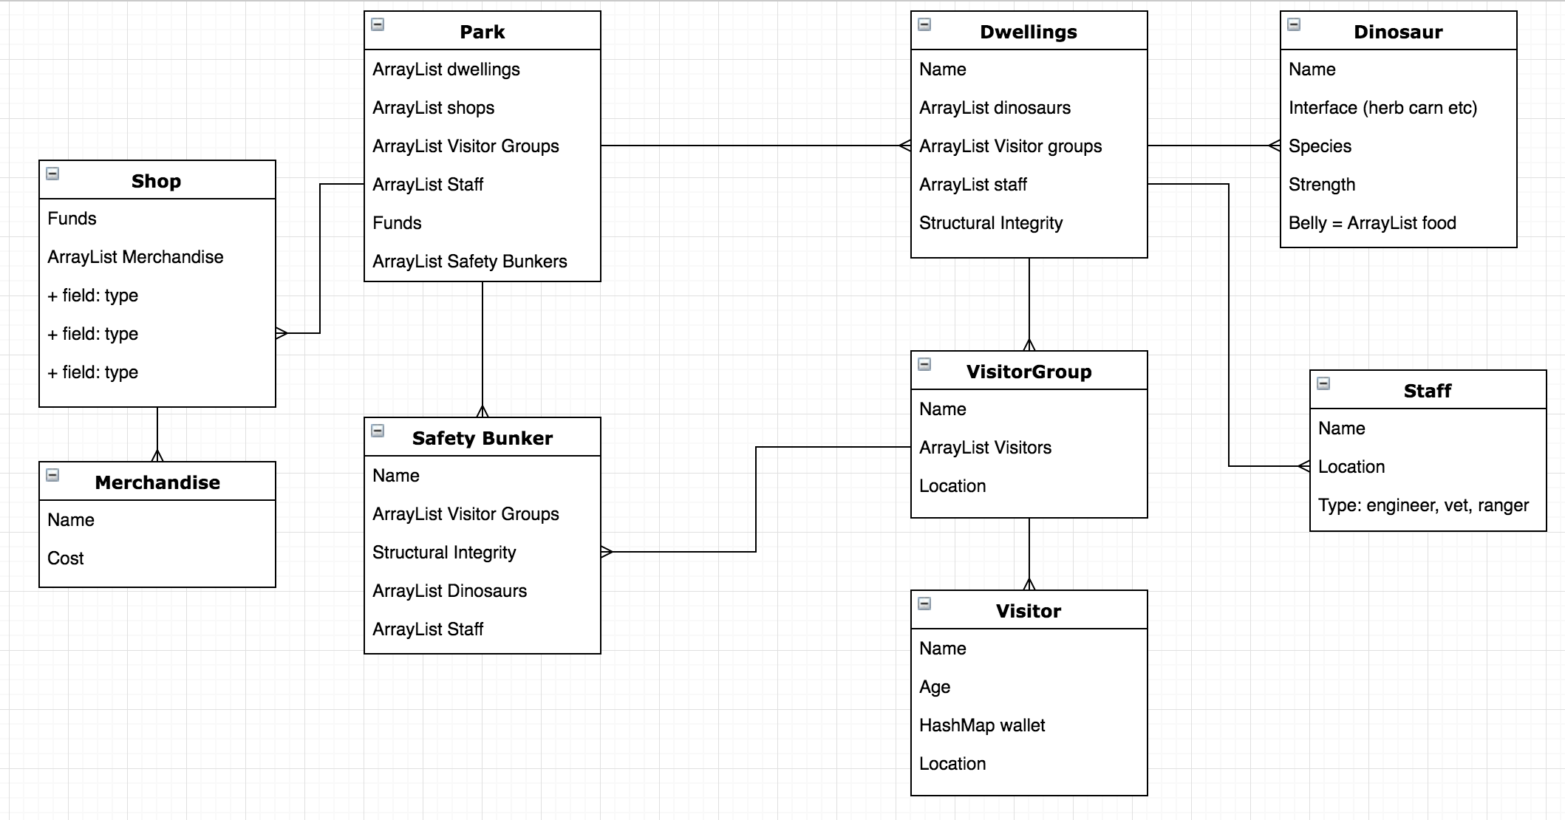

Slide 5
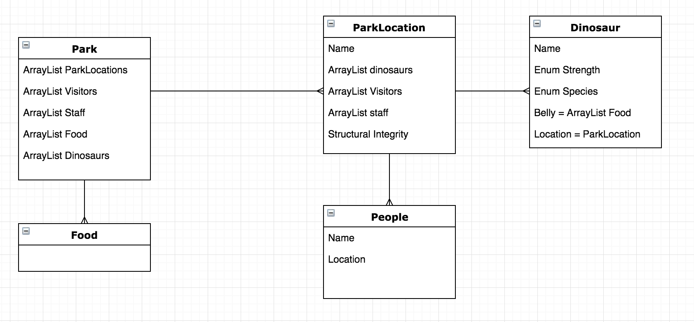

Slide 6
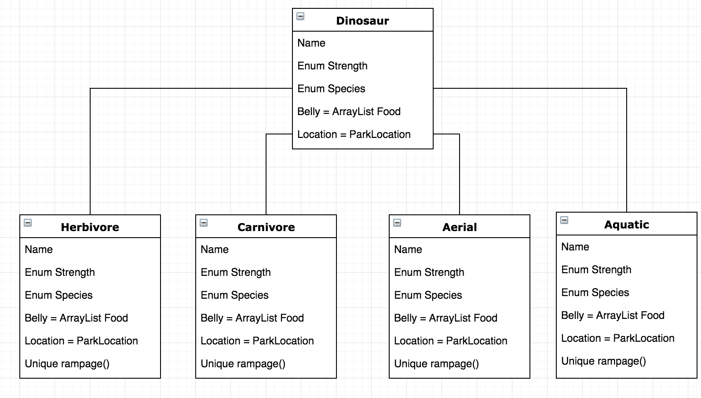

Slide 7
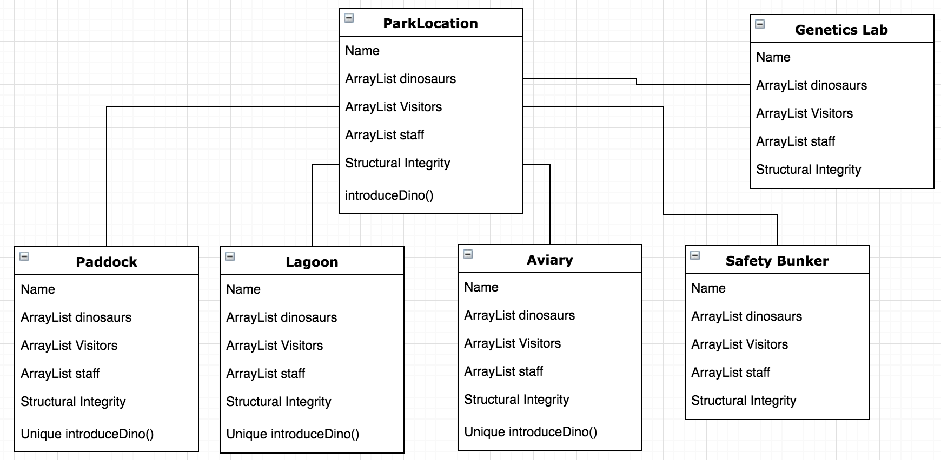

Slide 8
Oooo, a car, let’s test it!

Slide 9
Wanna test me?
NOPE.

Slide 10
An hour later
Y U NO PASS?!
Won’t pass?
Being stubborn I see

Slide 11
Objectives met?
MVP met
Some of my extensions met
Runner file added – Was unsure about if this was MVP or not
Code was relatively solid and dry – until I wrote the park
Proudest bit of code – JurassicPark
Worst bit of code – JurassicPark

